Slide 1
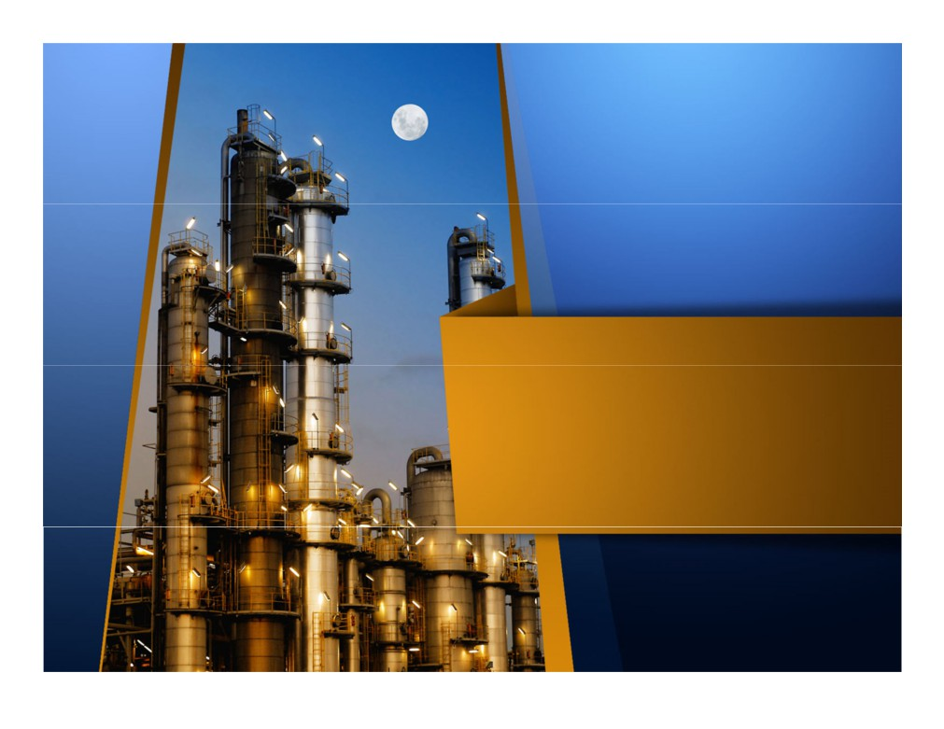
Introduction to Oil and Gas Industry
Upstream Midstream Downstream

Slide 2
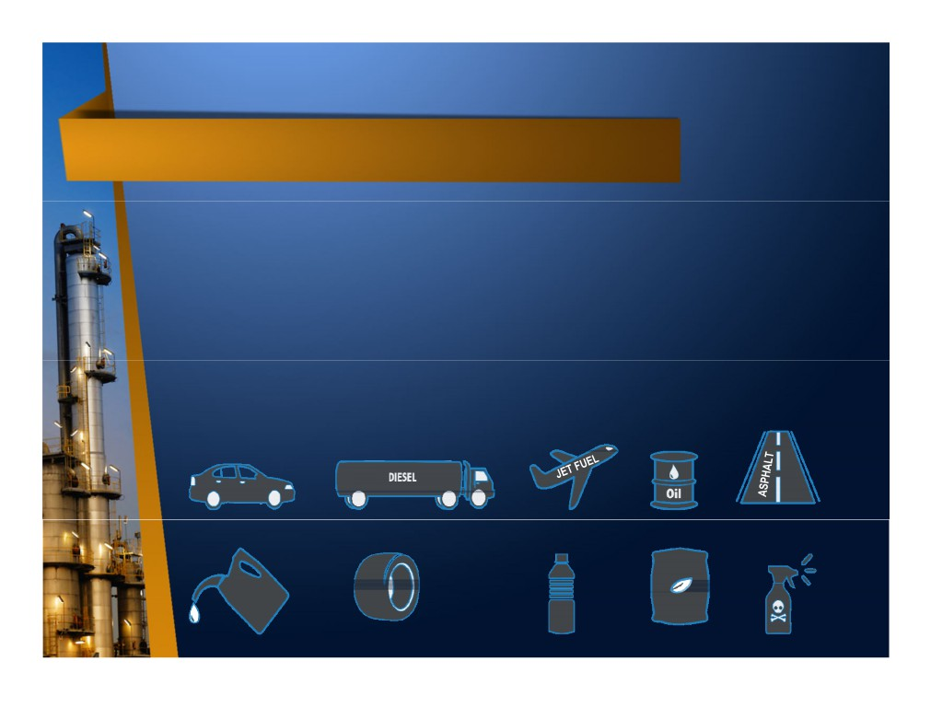
Oil & Gas in Our Life
• Transportation Fuel (gasoline, diesel fuel, jet/aviation fuel, marine fuel oil, compressed natural gas/CNG)
• Power Plant Fuel (natural gas, diesel fuel)
• Household Fuel (heating oil, liquefied petroleum gas/LPG, kerosene)
• Petrochemical Products (plastic, fertilizer, synthetic fiber,
synthetic rubber, insecticides, pharmaceuticals, detergent,
paints, creams, solvent, industrial chemical, industrial gas, etc)
• Asphalt
GASOLINE
HEATING
SYNTHETIC
PLASTICS
PESTICIDES
RUBBER
LUBRICANTS
FERTILIZER

Slide 3
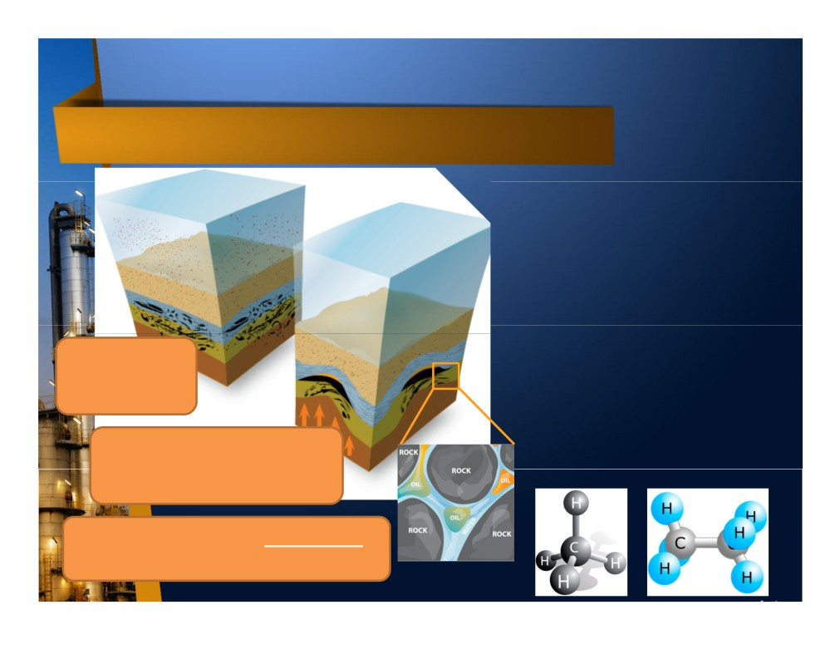
Oil & Gas Formation
• It is formed from the
accumulation of decomposition of plants and marine animals which died million years ago and trapped beneath the ground under high pressure and temperatures.
Dead organism get trapped
• Oil & gas compound consist of Carbon & Hydrogen Atom, that’s
underground
why it is called HYDROCARBON.
• Crude Oil is liquid while Natural
High Temperature & Pressure transform buried dead
Gas is gaseous hydrocarbon at room temperature.
organism into oil & gas
Oil & gas is also called PETROLEUM which means “Rock Oil” in Latin word

Slide 4
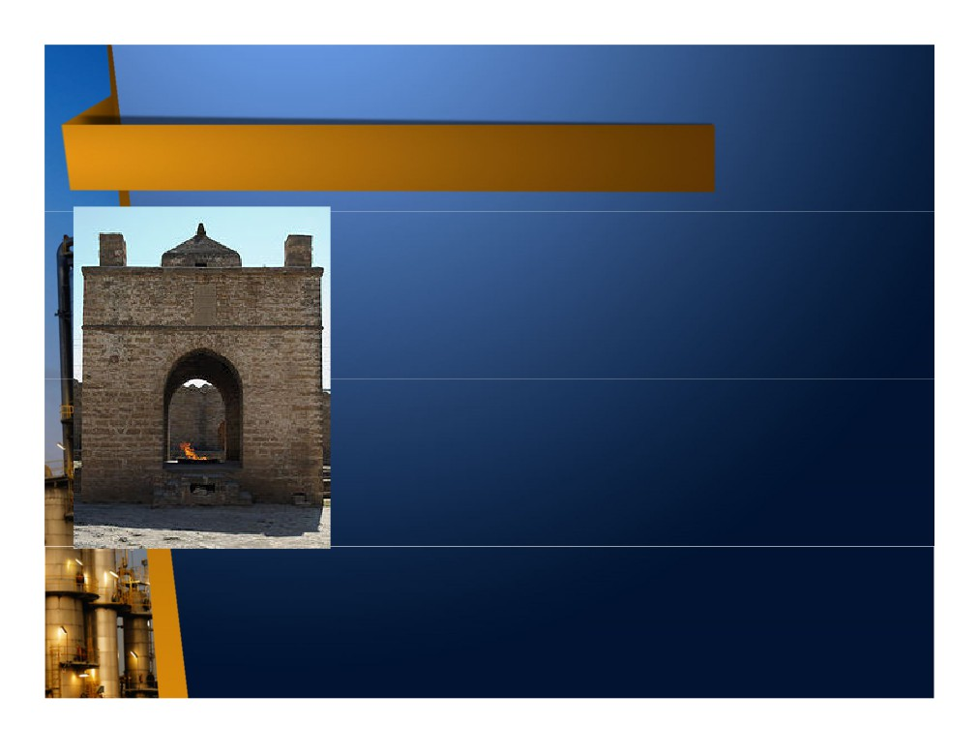
Oil & Gas Early History
• Oil & gas had been used for centuries like ancient peoples worshipped sacred fires (eternal flame) fuelled by natural gas seeping to the surface through pores and cracks.
• About 6000 BC, thick gummy asphalt was used to waterproof boats and heat homes.
• About 3000 BC, the Egyptians used asphalt in the construction of the pyramids, to grease axles of the Pharaoh’s chariots, and as an embalming agent for mummies & medicines.
Eternal flame at
• When whale oil (extracted from whale fat), the main source of lamp fuel in early 1980,
Ategash Fire Temple, Baku Azerbaijan
became scarce, a new source is introduced by distilling natural petroleum seeps and coal into lamp oil / kerosene.

Slide 5
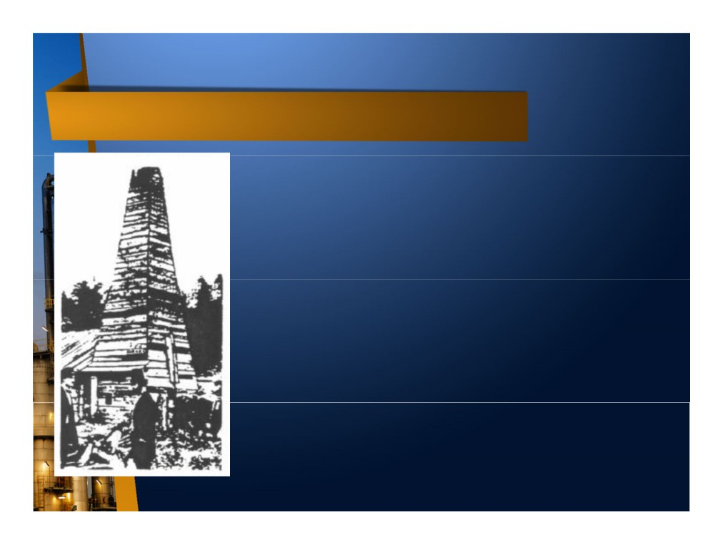
Birth of Modern Oil & Gas Industry
• First refinery begun in 1846 when Abraham Gessner of Nova Scotia, Canada, invented a process to produce kerosene for lamp from coal.
• In 1858, James Miller Williams , a 39 year old
carriage maker from Ontario, Canada, made the first major commercial oil discovery in North America at Oil Springs, Ontario, Canada.
• He struck oil at a depth of only 18 m by drilling in "gum beds" in Lambton County, 25 km southeast of Sarnia. Williams refined the oil he produced and sold the product as lamp oil.
• In 1859, Colonel Edwin L. Drake discovered oil in Titusville, Pennsylvania by drilling to 21 m. This discovery marked the birth of the modern petroleum industry in the United States.
• The invention of the gasoline engine (1885) and
diesel engine (1892) boosted the refineries industry to produce gasoline and diesel fuel.
Drake Well

Slide 6
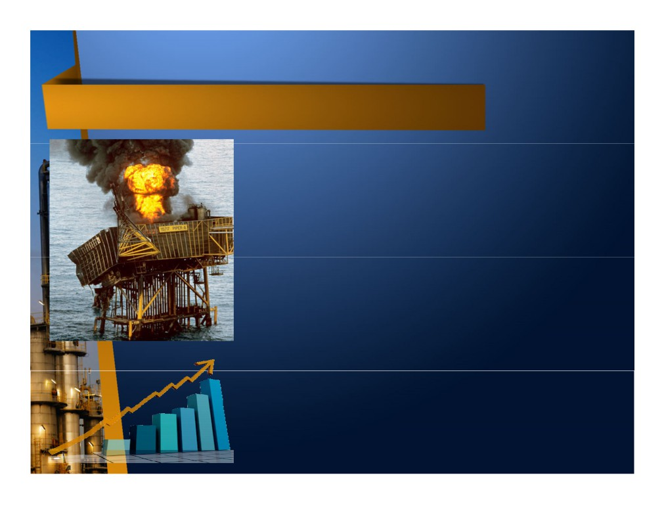
Oil & Gas Industry Characteristics
• Large investment, can reach billion of US$.
• High Risk in all aspects (people safety, environment, investment, reputation).
• Many uncertainties, especially upstream industry.
• Long term business from initial investment until revenue generated, even longer until break even point.
• Complex operation, involves multi
discipline experts from both technical and non-technical.
• High reward.
• Strategic value (economic & politic).
• Global impact.

Slide 7
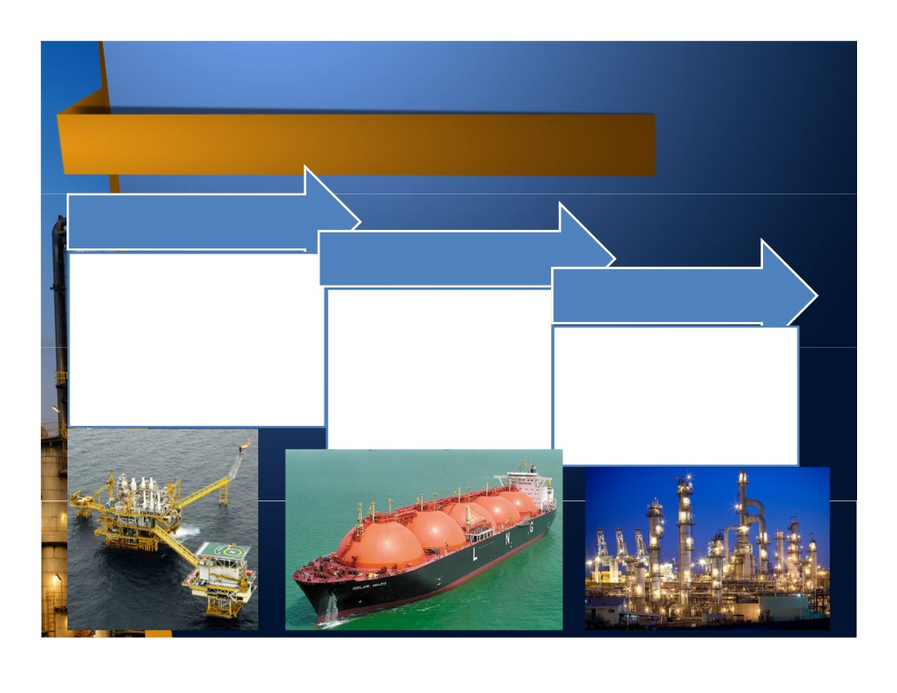
Oil & Gas Industry Sector
Upstream
Midstream
Finding, lifting, and
processing oil & gas from subsurface into surface and ready for transportation. Also known as Exploration and Production (E&P).
Downstream
Transportation and storage of crude oil and natural gas from E&P plant for further
Further processing of crude oil and natural gas into
processing by pipeline, railway, road, or tanker.
useful final product or raw material for other industry.

Slide 8
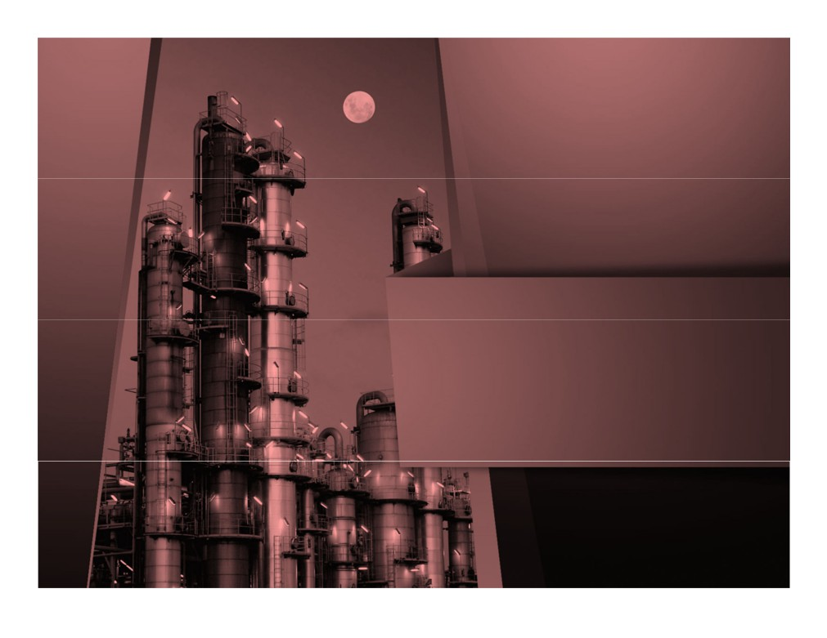
UPSTREAM

Slide 9
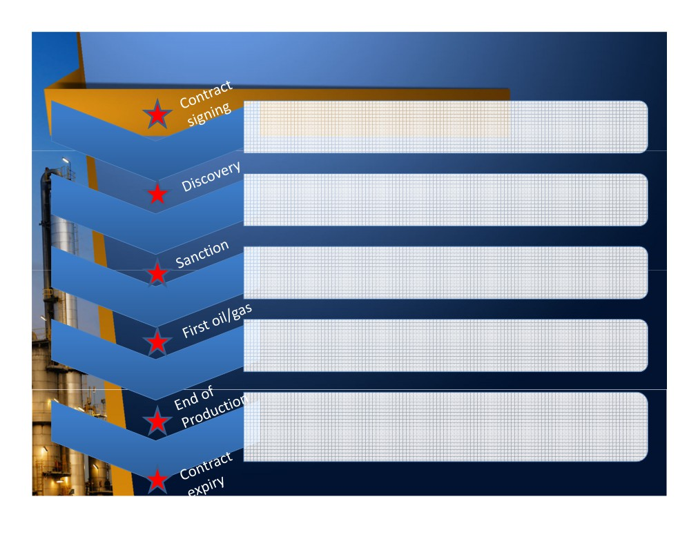
Upstream Oil & Gas Life Cycle
• Activities to search for oil & gas deposits on
Exploration
the reservoir beneath the earth’s surface
• Activities to define the oil & gas volume and characteristic more precisely after discovery
Appraisal
• Activities to build the subsurface & surface facilities to produce oil & gas safely and efficiently
Development
• Activities to extract, process, and export oil & gas as per contract agreement
Production
• Activities to plug wells permanently, remove surface facilities, and restore the field as per initial state
Abandonment

Slide 10
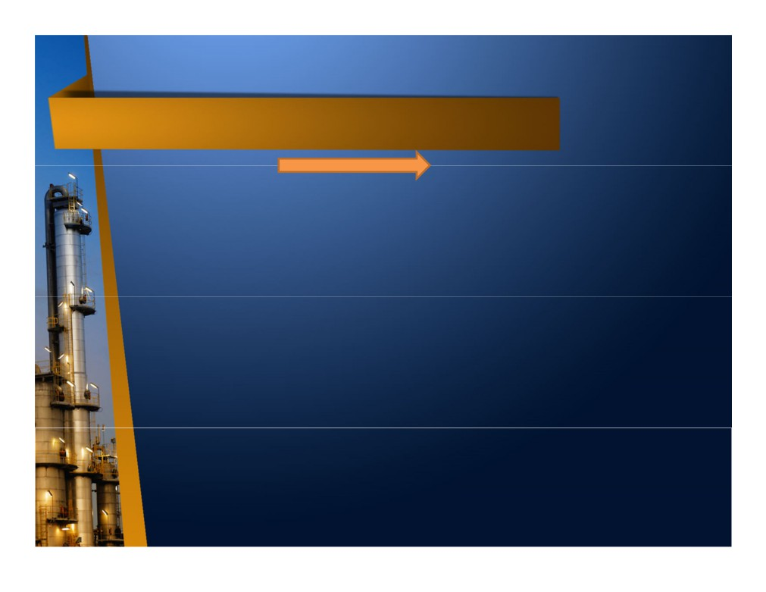
Exploration & Appraisal
Exploration
Appraisal
• Activities to find oil & gas prospect beneath the earth surface by
• It is required to determine the reservoir size which define the
means of gravity survey, magnetic survey, and seismic reflection
volume & to get better characteristic of oil & gas.
survey.
• Volume will be measured in
• Once prospect is likely to be found, exploration (wildcat) drilling will be
million barrels (MMbbls) oil and billion cubic feet (Bcf) gas, both original in place volume (Oil
conducted to determine the presence of oil & gas reserve.
Initial In Place / OIIP and Gas Initial In Place / GIIP) &
• Most wildcat drilling fail to find oil
recoverable volume.
& gas (dry hole), only few (less than 25%) hits oil & gas layer (discovery).
• Important characteristic includes pressure, temperature, oil
viscosity, hydrocarbon composition,
• After discovery, more drilling is required to “appraise” the
compartmentalization, and contaminants.
reservoir.

Slide 11
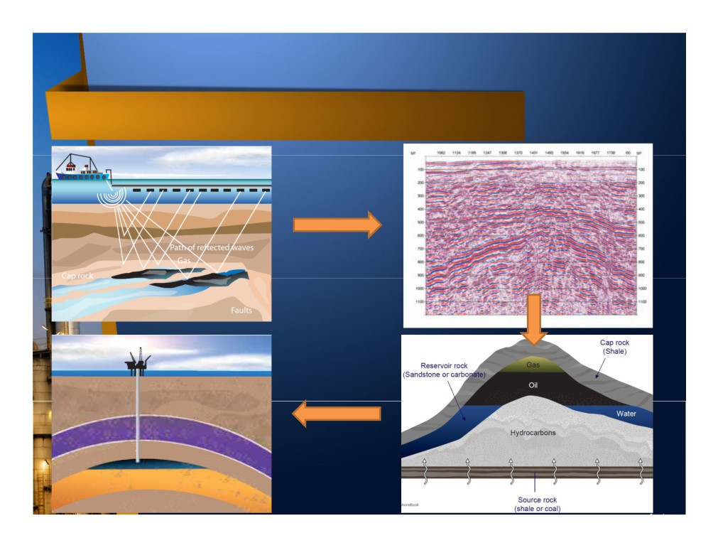
Seismic & Drilling
1. Seismic
2. Seismic 2D imaging
3. Further modelling
4. Drilling

Slide 12
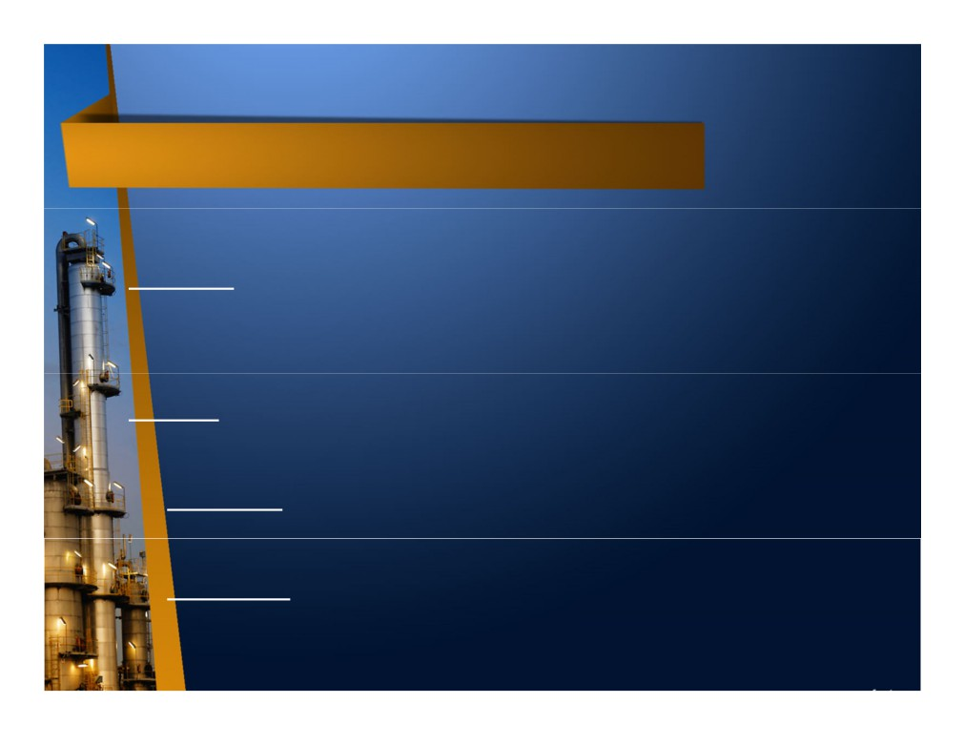
Reserve Type
• Once appraisal conducted, it will determine the quantity of petroleum which can be recovered / produced. Typically, only 30% of oil and 70% of gas can be recovered, can be more if advance technique applied like water injection & submersible pump.
• Proved (1P) : Quantities of oil and gas, which, by analysis of geoscience and
engineering data, can be estimated with reasonable certainty to be economically producible-from a given date forward, from known reservoirs, and under existing economic conditions, operating methods, and government regulations. At least 90% probability (P90) that the quantities actually recovered will be equal or exceed the estimate.
• Unproved : Reserves are based on technical data similar to that used in estimates of proved reserves; but technical, contractual, economic, or regulatory uncertainties preclude such reserves being classified as proved. Unproved reserves may be further classified as probable reserves and possible reserves.
- Possible (2P) : Unproved reserves which analysis of technical data suggests are more likely than not to be recoverable. At least a 50% probability (P50) that the quantities actually recovered will equal or exceed the sum of estimated proved plus probable reserves.
- Probable (3P) : Unproved reserve which analysis of technical data suggests are less likely to be recoverable than probable reserves. At least a 10% probability (P10) that the quantities actually recovered will equal or exceed the sum of estimated proved plus probable plus possible reserves.

Slide 13

Field Development Plan (FDP)
• Once the estimated recoverable value is determined, the Company will prepare a plan to monetize the reserve, called Field Development Plan / Plan of Development (PoD).
• FDP shall contain at least :
Subsurface characteristic (OIIP, GIIP, contaminants, etc) Recoverable reserve in P90-P50-P10
Production Rate & Field Life
Production Facilities (number & type of wells, surface facilities type) Project Plan (including Cost, Schedule, Quality)
Project Economics
Other aspects like Risk, Health Safety Environment (HSE)
• FDP shall be approved by the host authority. Once approved, the Company will conduct a tender for facilities development.
• In the same time, Company will secure the hydrocarbon sales, especially gas, known as Gas Sales Agreement (GSA). While for oil, it will be absorbed by the market as per oil price trend.
• Once the GSA secured and cost of development known from proposed tender price, the Company will further calculate the project economic. If it meet the criteria, the Company will sanction (commit to invest money) the project, known as Final Investment Decision (FID)

Slide 14
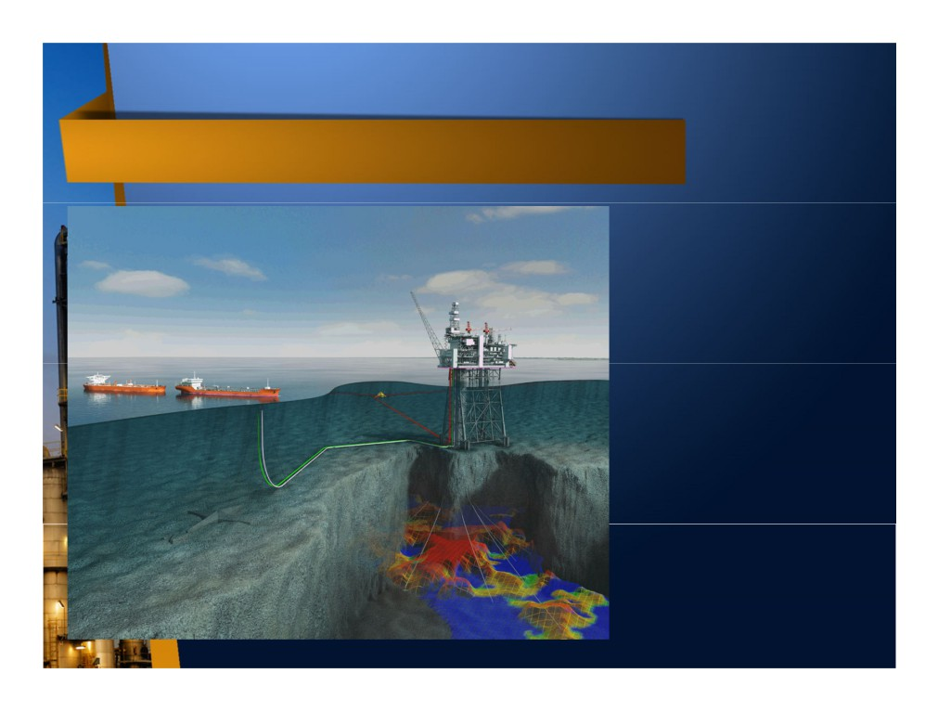
Production Facilities
• A set of equipment to extract (lift) oil & gas from subsurface to surface, process, & export it to customer as per requirement specified in the
Offshore
contract.
Oil tanker
Surface Facilities
• Based on the location, it consists of
FPSO
subsurface (wells) & surface facilities.
Wells
• Optimum facilities size will depend on
reservoir size & contract duration
which will define the optimum production rate
Reservoir

Slide 15
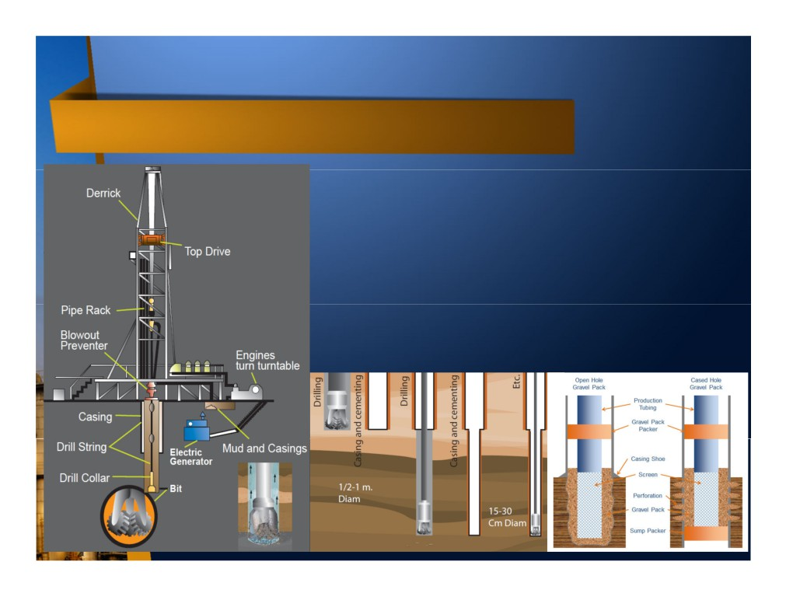
Drilling & Completion (Wells)
• A well is created by drilling a hole into the earth by using a drilling rig that rotates a drill bit.
• Once drilled, a steel pipe called casing is placed in the hole & secured with cement. This process is continued by using smaller drill bit & casing until reach the reservoir target.
• After reaching the target, well must be “completed”. The process to prepare the well to produce oil & gas is called “completion”.
• Completion is designed to allow oil & gas to flow but to block unwanted material like sand.

Slide 16
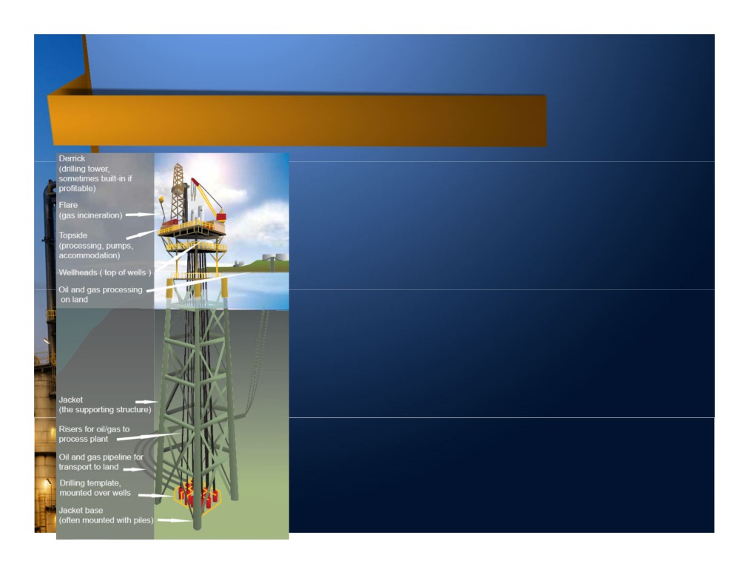
Surface Production Facilities
• Surface Facilities consist of wellhead, processing, and exporting facilities.
• Wellhead is the top part of the wells which is
used to control the flow, protect from excessive pressure, and interface between surface and reservoir.
• Main processing function is to separate the mixture of oil, gas, water, and other contaminants (i.e. CO2, H2S) and to condition the crude oil and natural gas as per required sales specification.
• Once crude oil processed, it will be exported through pipeline, oil tanker, truck, or railway.
• For natural gas, it can only be exported by
pipeline. If the volume is too big or the distance is too far, gas has to be liquefied and exported in liquid phase by LNG tanker.
• Based on the location, it can be placed on land (onshore) or sea (offshore).

Slide 17
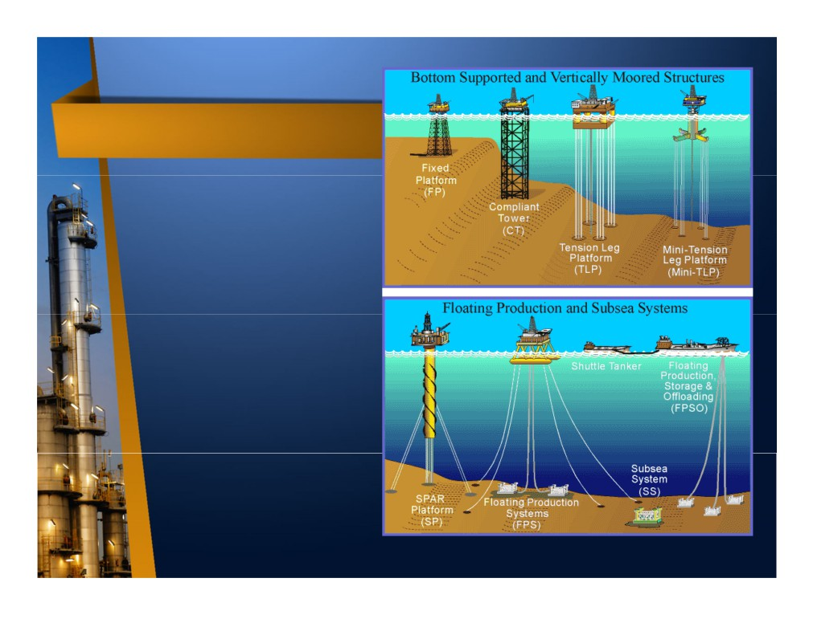
Offshore Facilities
• Based on the
substructure (the structure which supports the
equipment above called topside), offshore facilities is divided into :
Bottom Supported & Vertically
Moored
Floating & Subsea

Slide 18
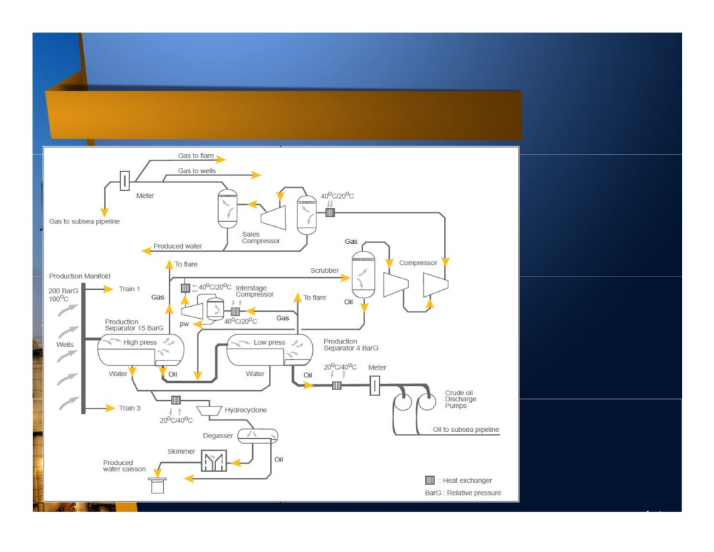
Oil & Gas Processing Facilities
• Oil-gas-water
mixture is
separated in separator.
• Oil will be stabilized by removing more gas, then pumped to pipeline or
FPSO.
• Gas will be treated to remove more
liquid, then
compressed to pipeline.
• Water will be treated before disposed
overboard / re- injected into reservoir.

Slide 19
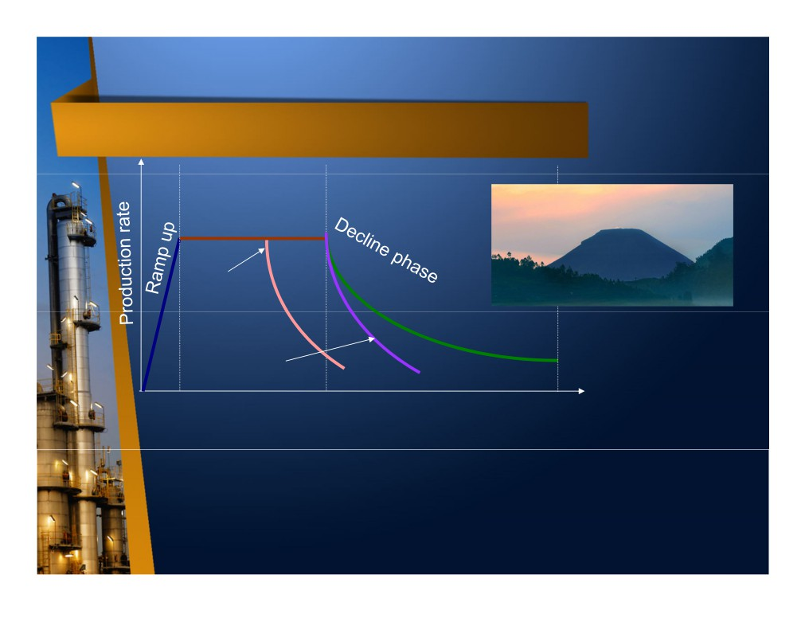
Production Period
Plateau phase
Plateau
Primary
recovery
Tertiary recovery
Secondary
recovery
Time
• Typical production phase start with ramp up period (increase production rate up to peak, normally less than a year), then plateau (maintain peak for several years, for oil production normally less than 5 years while for gas production between 5 to 10 years), then declining until reach economic limit (timing when operating cost is higher than production revenue) or end of contractual period.
• Plateau & decline phase can be extended by applying secondary recovery (i.e. gas injection & water injection) and tertiary recovery (i.e. chemical injection & steam injection), however cost to benefit ratio must be carefully calculated since secondary/tertiary recovery is more expensive than primary recovery.

Slide 20
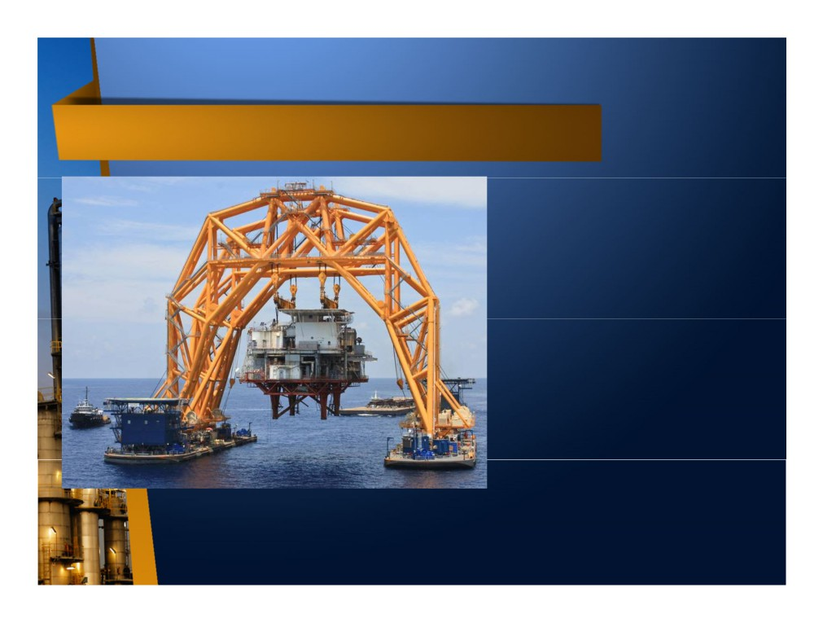
Abandonment
• The last phase in upstream life cycle is abandonment.
• The activities comprises well plug & abandonment (P&A) and surface facilities
removal.
• Well must be permanently closed and sealed, so no more hydrocarbon can escape to the surface.
• Surface facilities must be
removed until few meter
below seabed, or left on the seabed as an artificial reef after free hydrocarbon
Special vessel to remove offshore platform
condition reached.
• Site must be restore to as close as its original
condition.

Slide 21
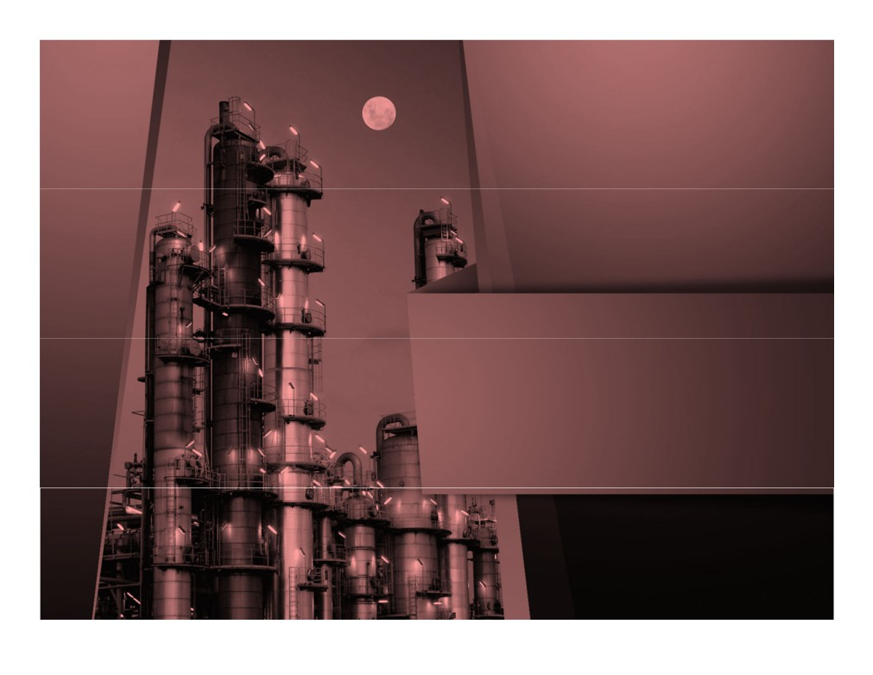
MIDSTREAM

Slide 22
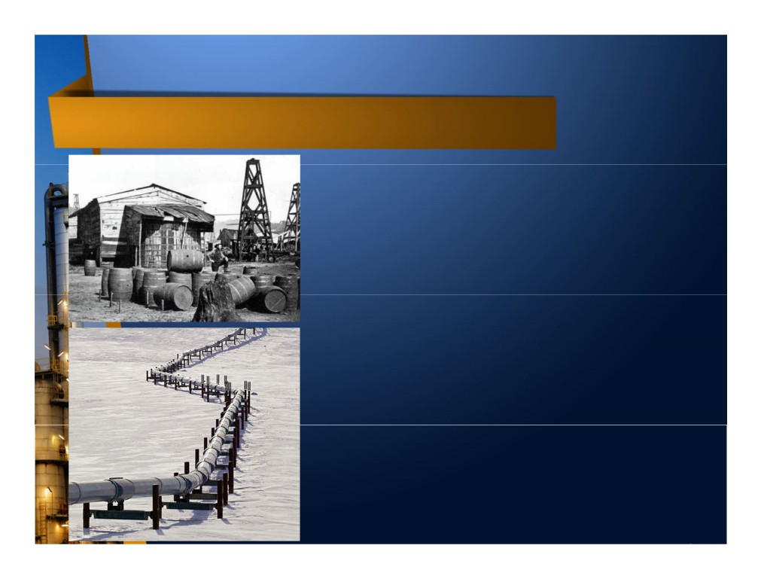
Oil Transportation - Onshore
• Since most of the oil & gas field is located far from the civilization, it is crucial to deliver the crude oil & natural gas to increase its value.
• Initially, produced oil is stored inside wooden barrel which then delivered by using horse carriage. It is the beginning of using “barrel” as oil volume measurement unit.
•
1 barrel = 42 US gallon = 159 liter.
•
After invention of gasoline & diesel engine,
horse carriage is replaced by truck & train.
• Once the volume getting bigger and the distance getting further, barrel method become uneconomic and pipeline was introduced.
• Pipeline is a long connected pipe to transfer liquid/gas. Pipeline characteristic is mainly defined by diameter, length, material, and thickness.

Slide 23
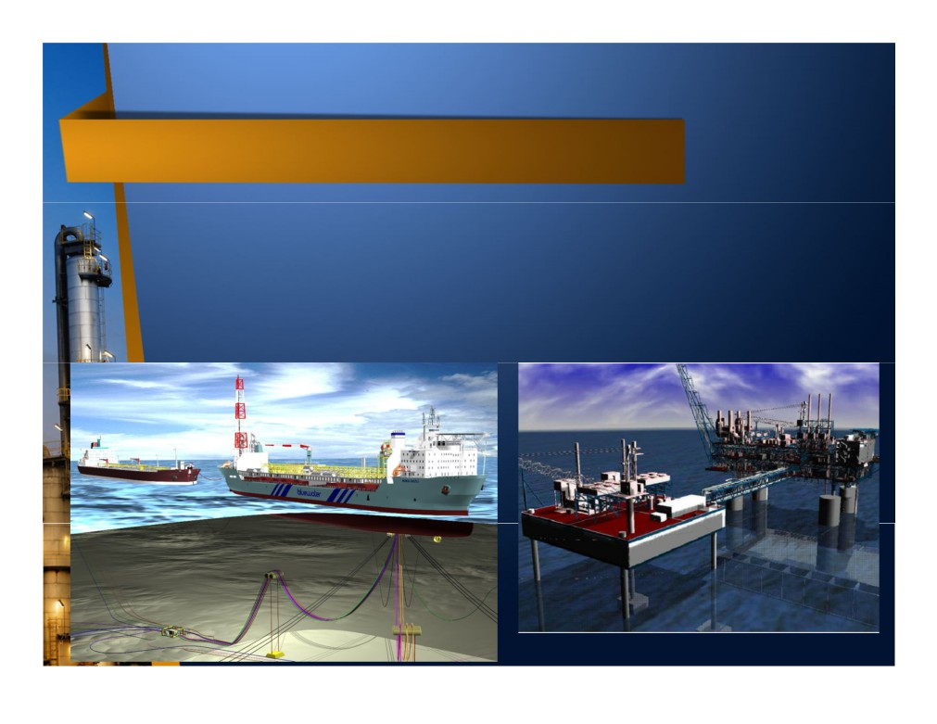
Oil Transportation - Offshore
• Normally, offshore pipeline laid on the seabed used to convey oil from offshore platform to onshore facility.
• However, if the distance is too far or the volume is too low, transporting liquid via pipeline can be technically and economically challenging.
• In this case, oil will be stored offshore (by using FPSO, FSO, or subsea storage) and then transported by using oil tanker.
Floating Production Storage Offloading
Oil Tanker
Subsea Storage

Slide 24

Gas Transportation
• Initially, gas is considered by-product which is only disposed by burning or commonly known as flaring.
• Only after gas can be monetized / sold (petrochemical plant, power plant), gas transportation is required.
• Since natural gas cannot be stored easily like liquid, produced gas has to be delivered soon after processed by using pipeline, either onshore or offshore.
• However, if the distance is too far and the volume is too big, pipeline become un-economical.
• In this case, gas has to be transformed into liquid phase by condensing it up to -162o C in atmospheric temperature to reduce its volume by 600 times, which is known as Liquefied Natural Gas (LNG).
• LNG can be transported in a specially designed cryogenic (very cool) tank attached to vessel (known as LNG tanker) or truck.

Slide 25
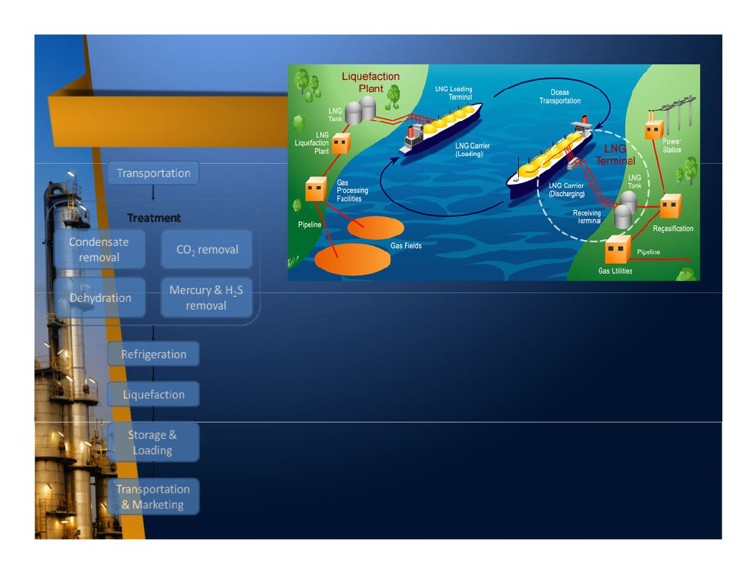
LNG process
• First LNG plant was built in Ohio, US, on 1940.
• LNG plant is very large and complex, hence initially it has to be built onshore.
• First, gas has to be purified to contain only methane
(CH4) & ethane (C2H6) since other material will freeze & block liquefaction process.
• Then, gas is cooled down by using cooler liquid known as refrigerant. To achieve very low temperature, cooling is done in several stage until gas liquefied.
• LNG is stored in a tank and ready for transportation.
• After delivered to receiving facility, LNG is transformed into gas again, known as regasification process.

Slide 26
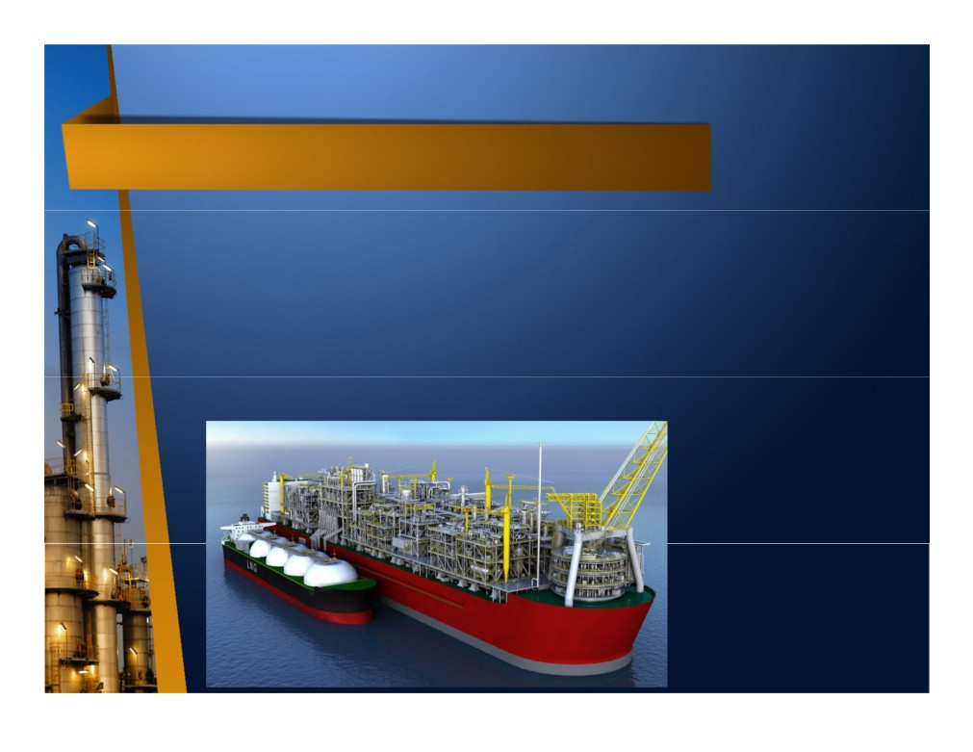
Floating LNG (FLNG)
• If large gas field is located very far from shore, transporting large quantity of gas via pipeline is technically & economically challenging.
• Small & medium size gas field located far from shore sometimes cannot justify the large investment to built LNG plant onshore.
• Another problem with onshore LNG is land acquisition.
• Long research had been conducted to bring LNG process and export facility into a floating platform.
• First Floating LNG project sanctioned is Shell Prelude on May 2015. It is located on Browse Basin, 475 km from Broome, Western Australia.
3D image of Shell
Prelude FLNG with LNG tanker along side. The FLNG size is
approximately 4 times football field, make it the largest vessel ever built so far.

Slide 27

DOWNSTREAM

Slide 28

Downstream Industry
• A portion of the industry that is responsible for the refining, distributing, and retail of petroleum products, sometimes also called Refining & Marketing (R&M).
• Refining means process the raw materials
(crude oil & natural gas) into higher value
product, either final product (ready to consume like LPG for home cooking) or intermediate product (raw material for further processing like ammonia for fertilizer).
• Downstream plants include oil refineries and petrochemical plants.

Slide 29
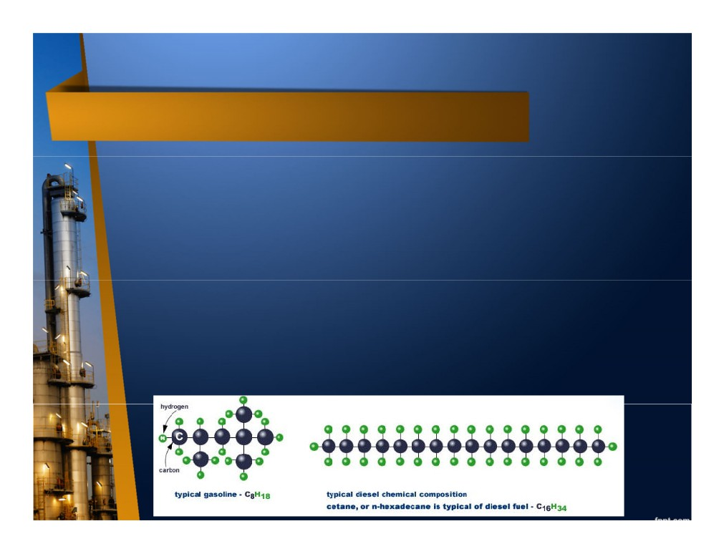
Oil Refinery
• Crude oils are not uniform, but rather are mixtures of thousands of different compounds called hydrocarbons. Each component of each compound has its own size, weight and boiling temperature.
• Crude oils have low value if not processed/refined.
• Petroleum refining is a physical and chemical process to transform crude oils into useful products.
• First, crude oils are washed in a desalter and then heated.
• Next, they enter the crude fractioner (tall vertical column) which
separate the oil components based on each component’s boiling point without chemical reaction.
• From crude fractioner, crude components are further processed,
sometimes involving chemical reaction, to create higher value products.

Slide 30
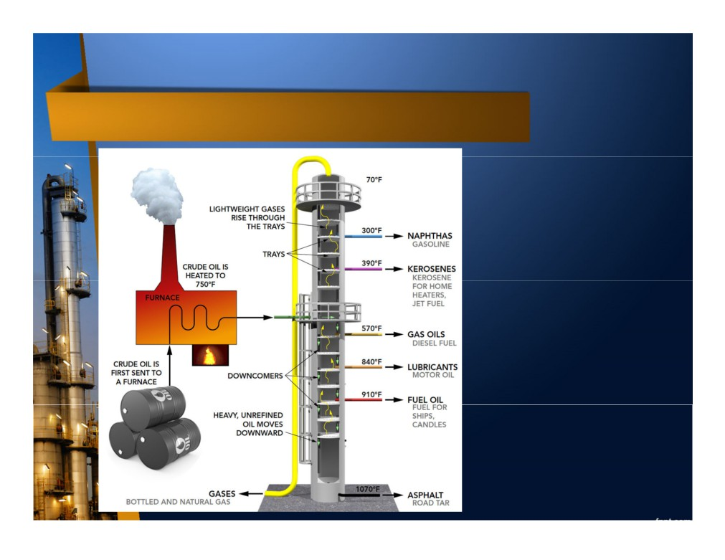
Simplified Oil Refinery Diagram
Refinery Products :
• Light distillates :
Liquid Petroleum Gas (LPG)
Gasoline (Petrol)
Naphtha (flammable liquid hydrocarbon mixtures)
• Middle distillates : Kerosene
Diesel Fuel Heating Oil Light Fuel Oil
• Heavy distillates : Heavy Fuel Oil
Bunker Fuel Oil Asphalt

Slide 31
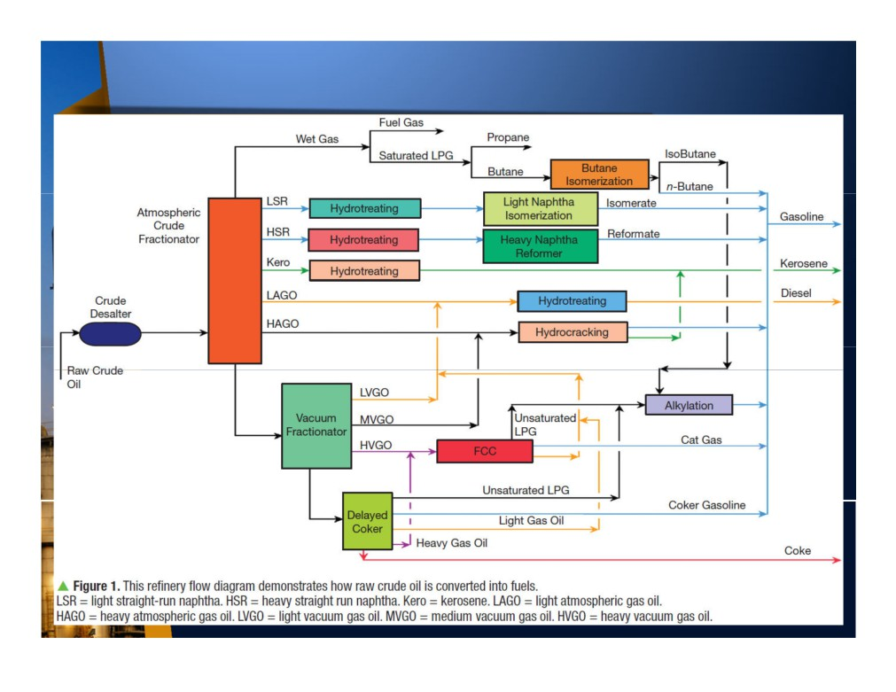
More Complex Oil Refinery Diagram

Slide 32
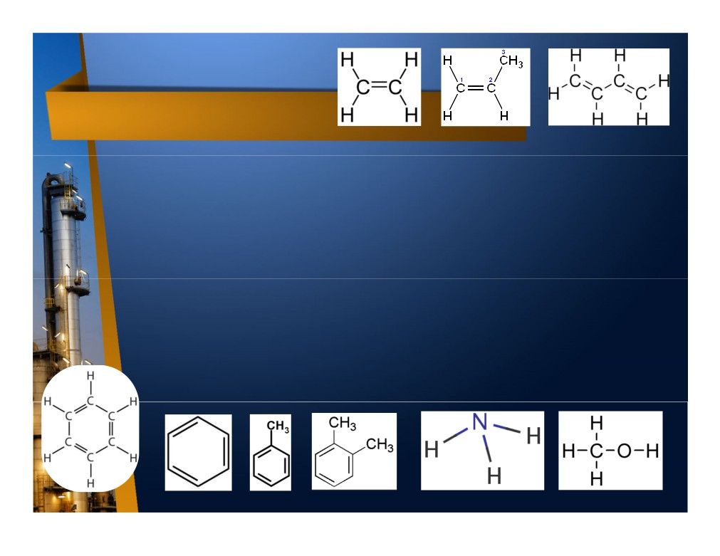
Petrochemical
ethylene
propylene
butadiene
• It is a chemical product derived from petroleum.
• Primary petrochemical are divided into 3 groups based on their chemical structures :
Olefins includes ethylene (C2H4), propylene (C3H6), and butadiene (C4H6). Ethylene and propylene are important sources of industry chemicals and plastic products. Butadiene is used in making synthetic rubber. Olefin is produced by fluid catalytic cracking of petroleum fraction or steam cracking of natural gas liquid.
Aromatics includes benzene (C6H6), toluene (C7H8), and xylenes (C8H10) or BTX. Benzene is a raw material for dyes and synthetic detergents. Benzene and toluene is used in making polyurethanes. Xylenes is used to produce plastics and synthetic fibers. Aromatics are produced by catalytic reforming of naphtha.
Synthesis gas is a mixture of carbon monoxide (CO) and hydrogen (H2) used to make ammonia and methanol. Ammonia is used to make the fertilizer urea and methanol is used as a solvent and chemical intermediate.
•
or
benzene toluene xylene
ammonia
methanol

Slide 33

Cracking Process
In petroleum geology and chemistry, cracking is the process whereby complex organic molecules such as kerogens or long chain hydrocarbons are broken down into simpler molecules such as light hydrocarbons, by the breaking of carbon-carbon bonds in the precursors.
The rate of cracking and the end products are strongly dependent on the temperature and presence of catalysts.
Cracking is the breakdown of a large alkane into smaller, more useful alkanes and alkenes.
More loosely, outside the field of petroleum chemistry, the term "cracking" is used to describe any type of splitting of molecules under the influence of heat, catalysts and solvents, such as in processes of destructive distillation or pyrolysis.
Fluid catalytic cracking produces a high yield of petrol and LPG, while hydrocracking is a major source of jet fuel, Diesel fuel, naphtha, and again yields LPG.

Slide 34
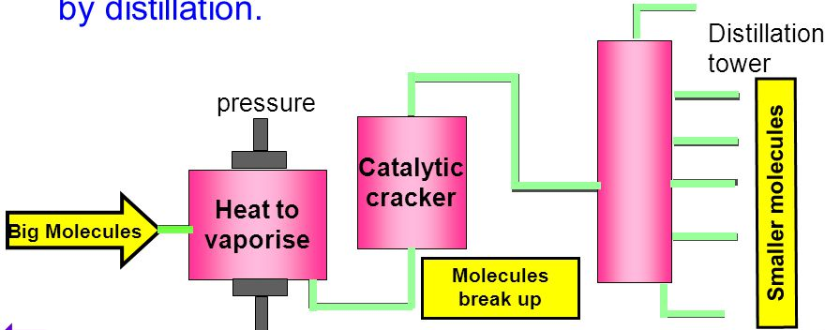
Catalytic Cracking
Large hydrocarbons are broken into smaller molecules using heat and a catalyst.
This process is known as catalytic cracking.
The small molecules produced are then separated by distillation.
VIDEO

Slide 35
Poly(e)thene
One important reaction of alkenes involves the joining together of alkene molecules.
H
H
H
H
H
H
H
H
H
H
And
lots
more..
H
C
C
C
C
C
C
C
C
C
C
H
H
H
H
H
H
H
H
H
H
1 2 3 4 5 thousands
This is called addition polymerisation and is written as:
Pressure
high
temperature
catalyst
poly(e)thene
n
n
ethene

Slide 36
Polypropene
Ethene is only one alkene. Other unsaturated molecules such as propene, vinyl chloride and styrene can also be polymerised to produce a range of plastics. E.g. propene
n
Poly(propene)
n
propene

Slide 37
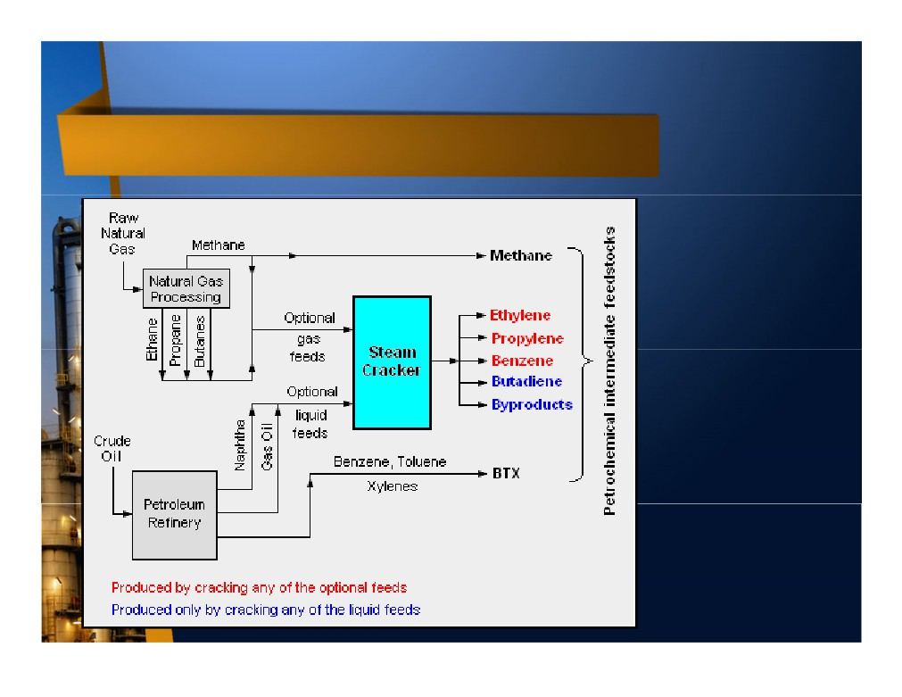
Petrochemical Simplified Diagram
Fluid Catalytic Cracking
is a chemical process using liquid catalyst to create new, smaller molecules from larger molecules (cracking) to make gasoline and distillate fuels.
Steam Cracking is a
chemical process using steam to thermally cracked the feedstock into lighter
hydrocarbon.

Slide 38
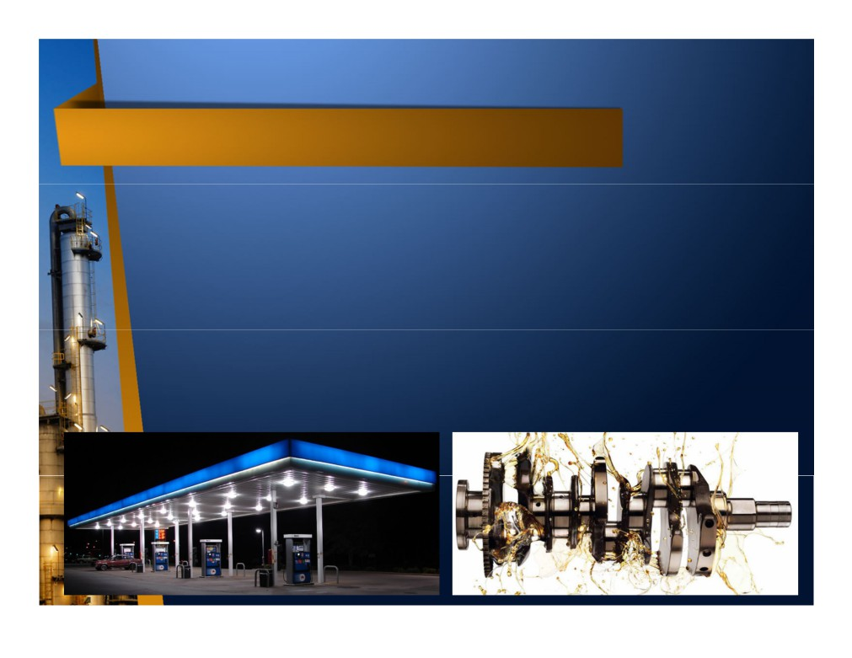
Marketing
• Downstream consumers includes commercial and retail consumers.
• Commercial consumers includes petrochemical & industrial
manufacturers, utilities (especially power plant), transportation fleets (airlines, trucks, vessels), and municipalities.
• Downstream industry may also only involve in distribution and sales of petroleum product, either to commercial or retail consumer, without having any plant.
• Downstream product pricing, especially mass product like gasoline, highly depends on oil price. However, specialized product like racing lubricant is less sensitive to oil price.

Slide 39
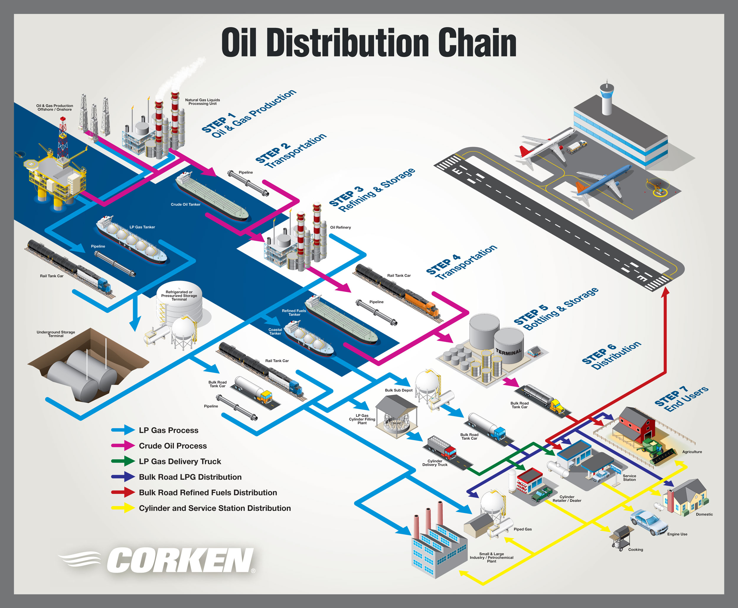
VIDEO

Slide 40
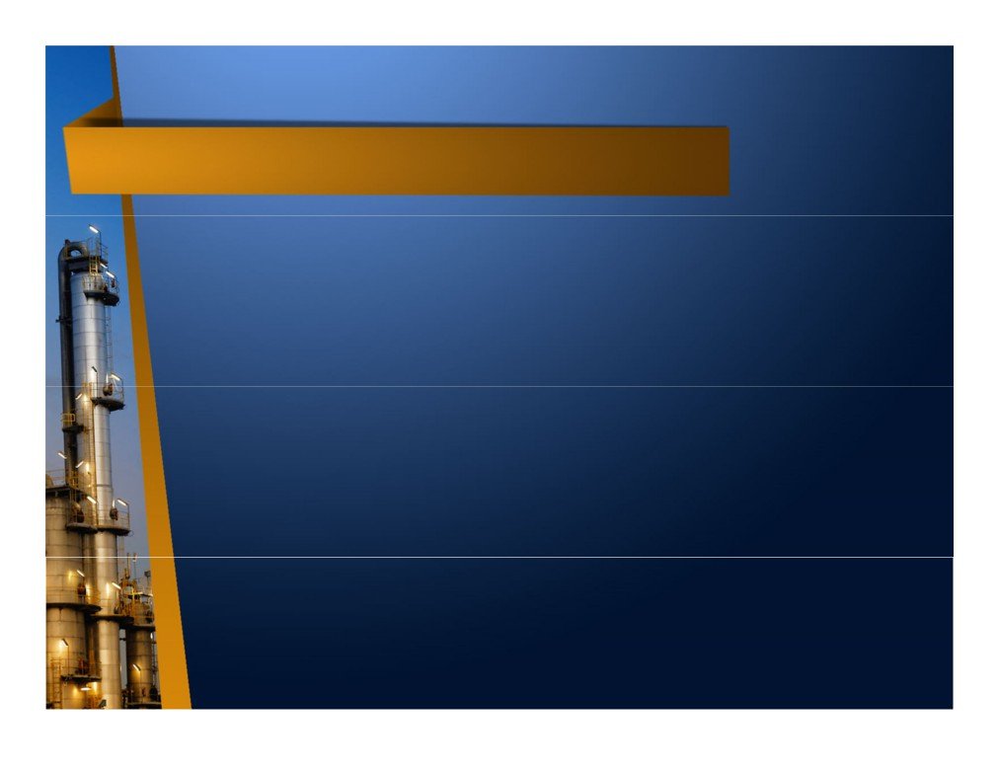
Oil & Gas Industry Sector Boundary
• Actually, the boundary between upstream, midstream, and downstream is sometimes not clear / gray area.
• Pipeline from upstream industry to downstream industry may be owned by upstream company or independent midstream company.
• LNG industry is normally considered midstream or
downstream industry, however with FLNG revolution, it is now part of upstream sector.
• Due to large investment & complex requirement,
normally a company only involve in one sector only,
however some very large companies involve in upstream- midstream-downstream sector, known as integrated oil & gas companies, i.e. Shell, ExxonMobil, and Petronas.

Slide 41
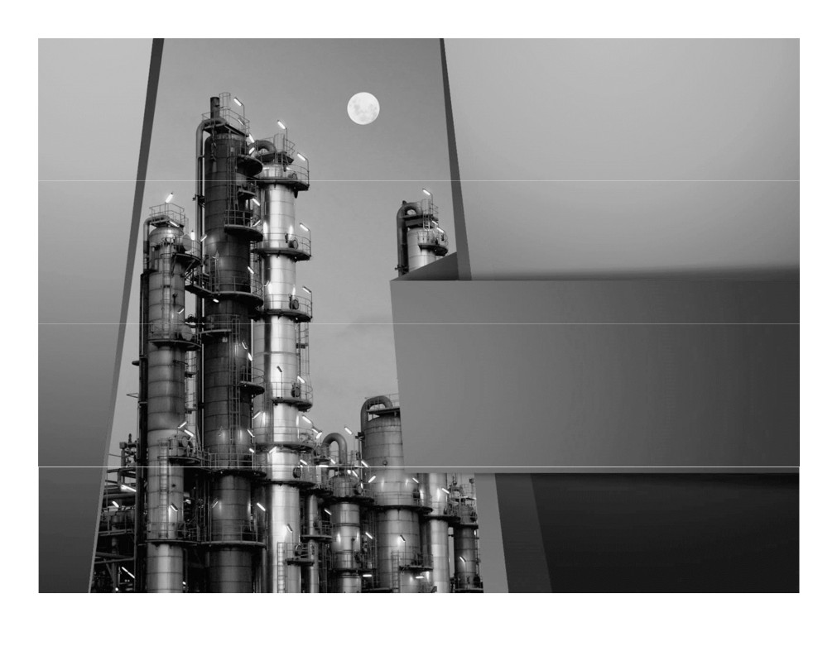
Thank You

